Slide 1
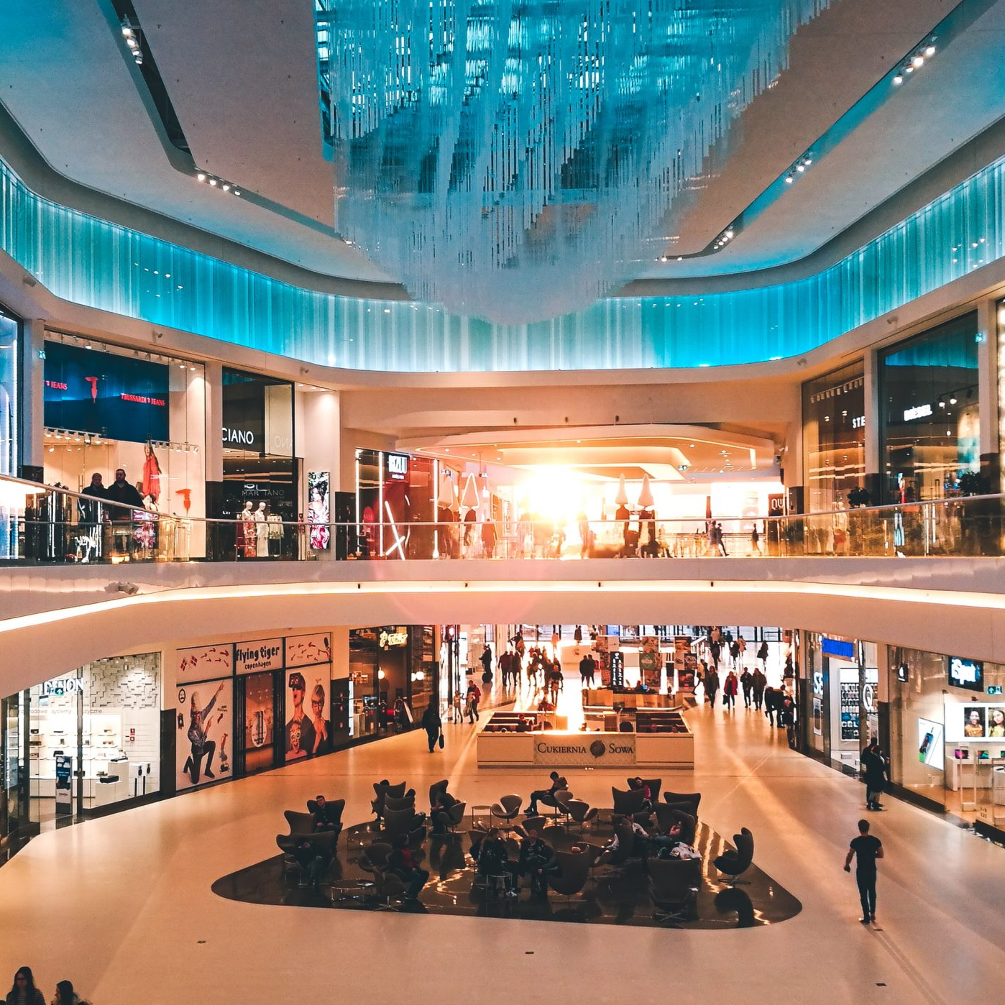
Mall CUstomer Segmentation
By Pooja vekal

Slide 2
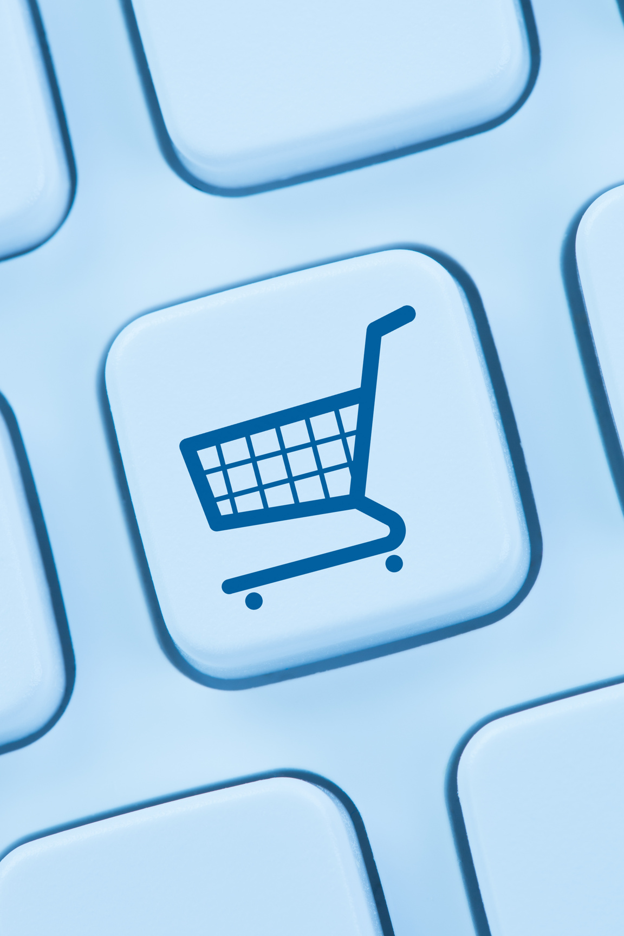
Problem Statement
Customer Segmentation is a popular application of unsupervised learning. Using clustering, identify segments of customers to target the potential user base. They divide customers into groups according to common characteristics like gender, age, interests, and spending habits so they can market to each group effectively.
To make predictions and find the clusters of potential customers of the mall and thus find appropriate measures to increase the revenue of the mall is one of the prevailing applications of unsupervised learning.
For example, a group of customers have high income but their spending score (amount spent in the mall) is low so from the analysis we can convert such type of customers into potential customers (whose spending score is high) by using strategies like better advertising, accepting feedback and improving the quality of products.
To identify such customers, this project analyses and forms clusters based on different criteria which are discussed in the further sections.

Slide 3
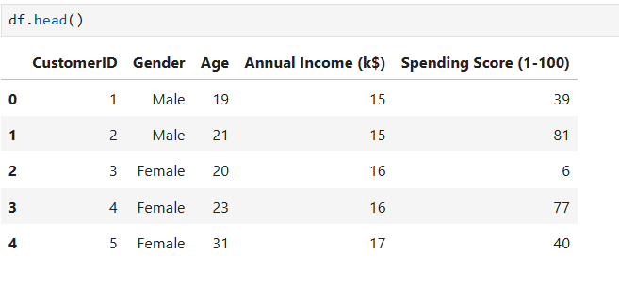
ABOUT THE DATA
This dataset contains basic information about mall customers, such as customer ID, gender, age, annual income (k$), and spending score (1–100)
A spending score is a score assigned to each customer based on their spending behavior.
Annual income is the annual income of the customer, typically measured in thousands of dollars (k).

Slide 4
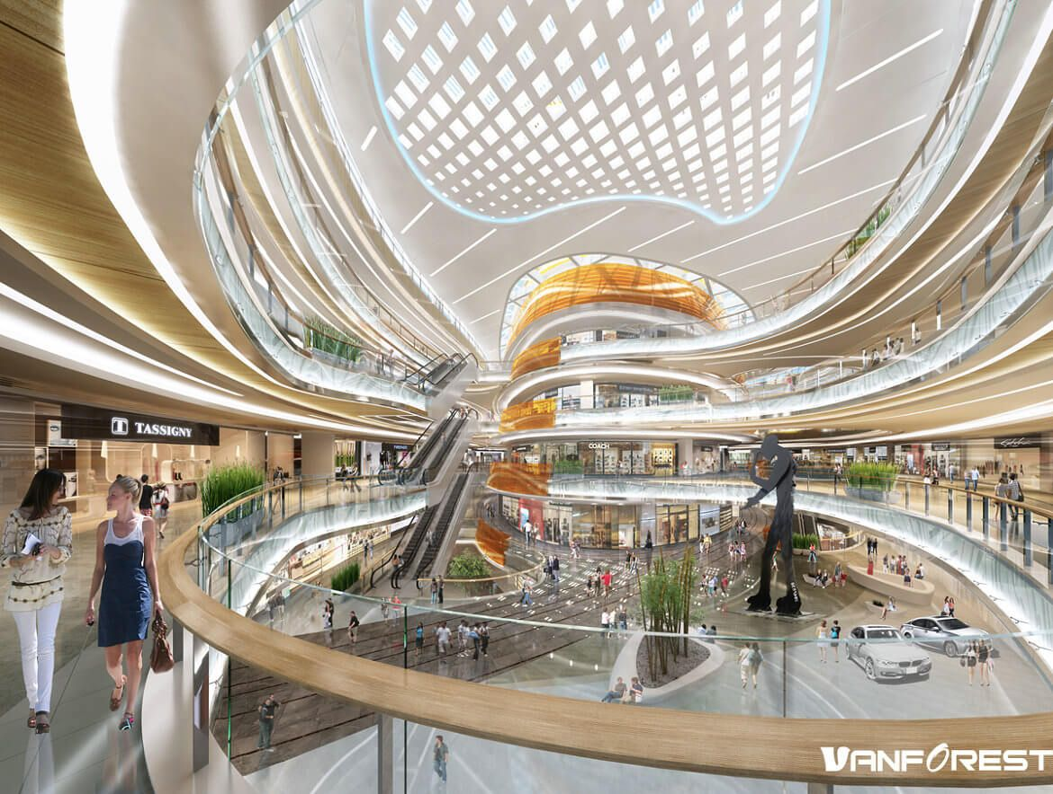
Objective Market Segmentation
Segmentation of the Mall's Target Market.
The process began by dividing the mall's overall target market into distinct, approachable groups.
Subsets of the market were created based on key demographic and behavioural criteria.
2. Creation of Market Subsets.
3. Enhanced Understanding for Marketing Activities

Slide 5
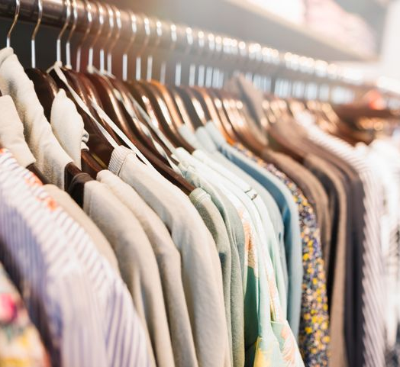
Data Cleaning
Checked for Missing Values.
Dropped the ‘ColumnID’ Column.
Performed Data Transformation on ‘Gender’ Column.
Standardized Column Names.
Renamed Columns

Slide 6
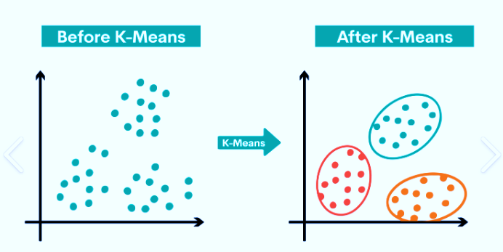
The Approach
Performing EDA(Exploratory Data Analysis)
Using KMEANS Clustering and DBSCAN Algorithm to create our segments.
Using Summary Statistics on the clusters.
Data visualization

Slide 7
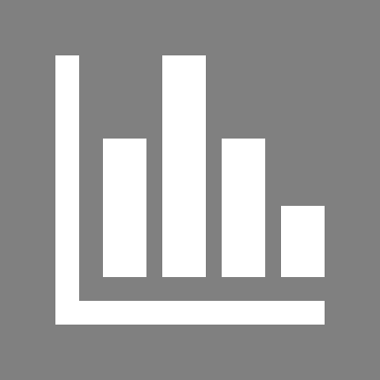
EDA
Gender Plot :

Slide 8
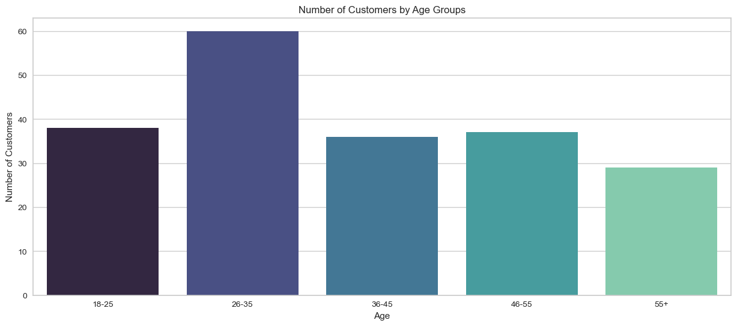
Age Distribution:

Slide 9
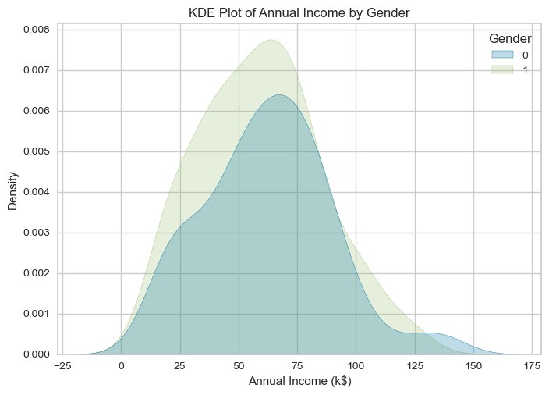
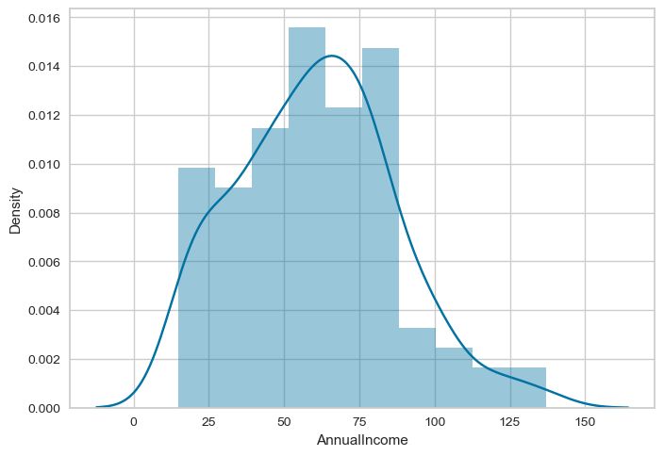
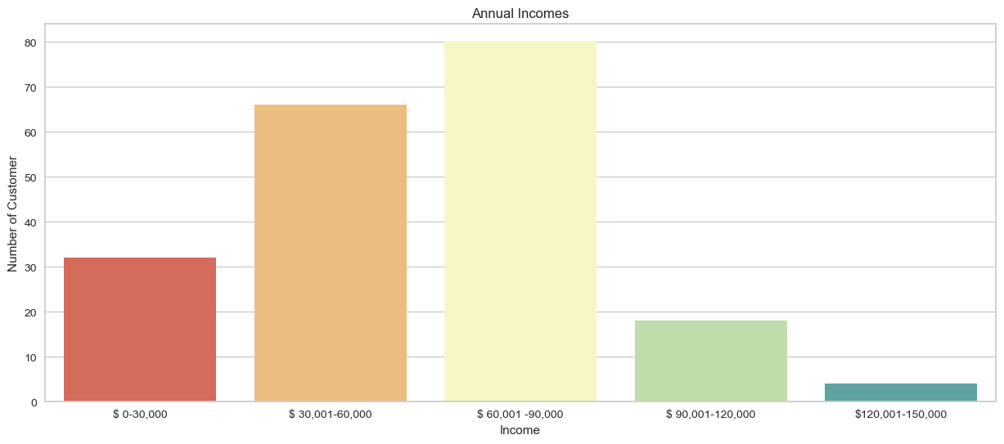
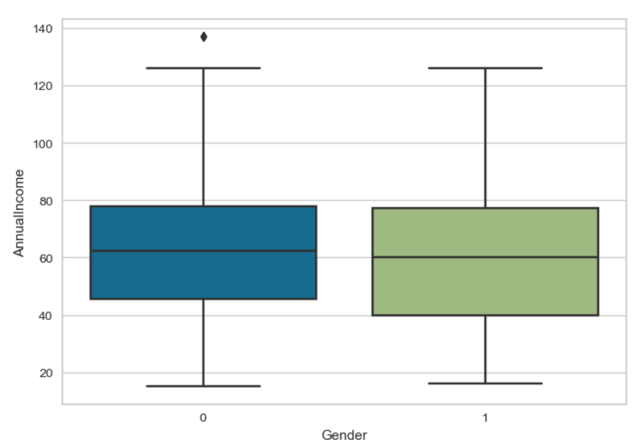
Annual Income Distribution:

Slide 10
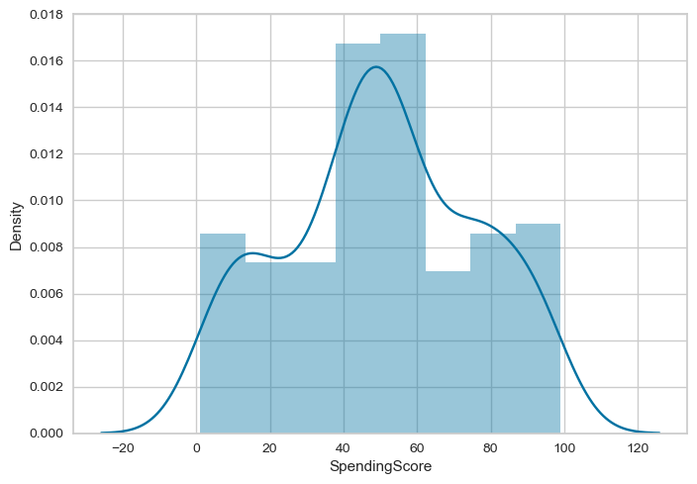
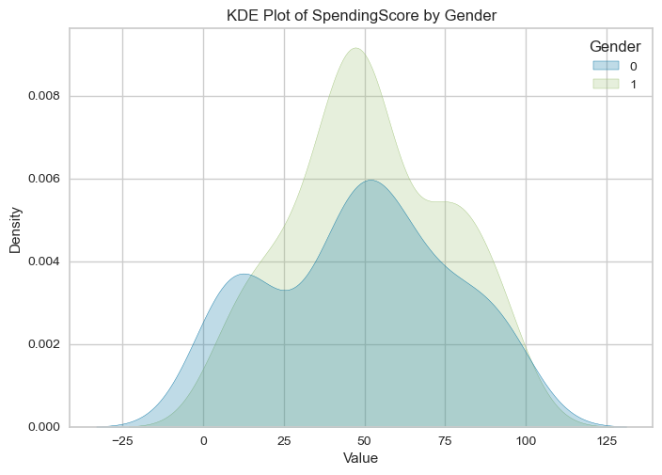
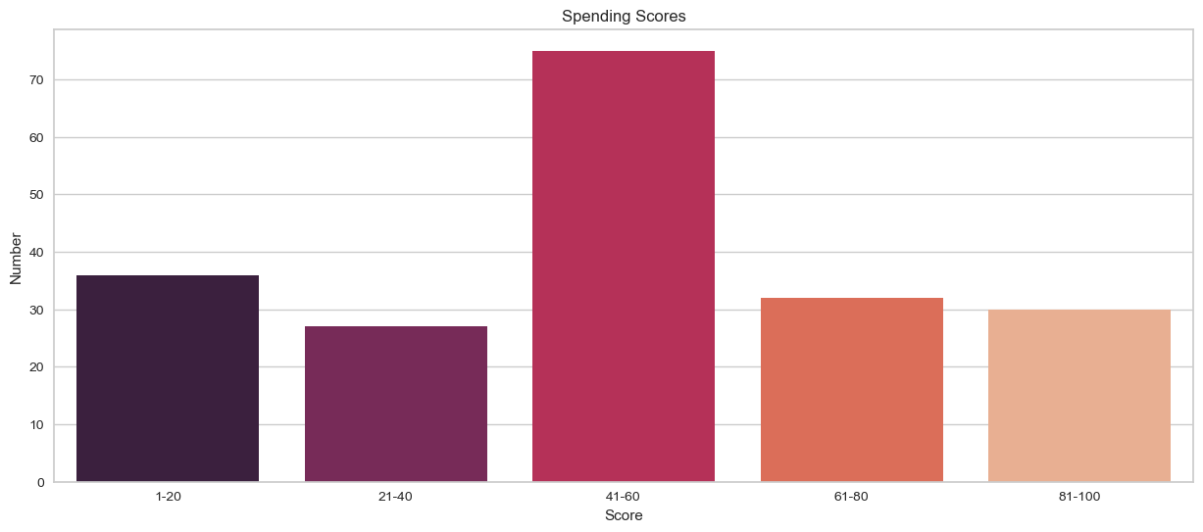
Spending Score Distribution:

Slide 11
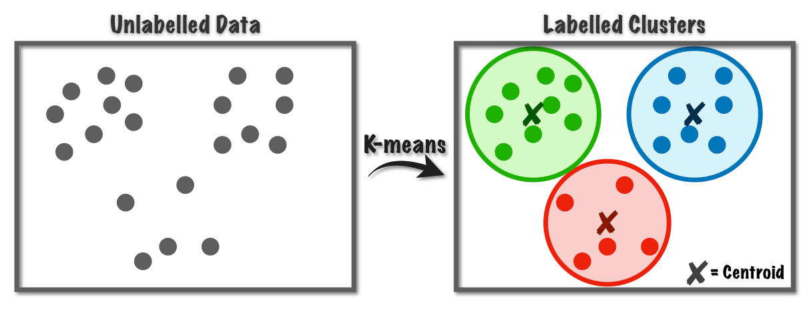
K -Means Algorithm
It is an iterative algorithm that divides the unlabelled dataset into k different clusters in such a way that each dataset belongs only one group that has similar properties

Slide 12
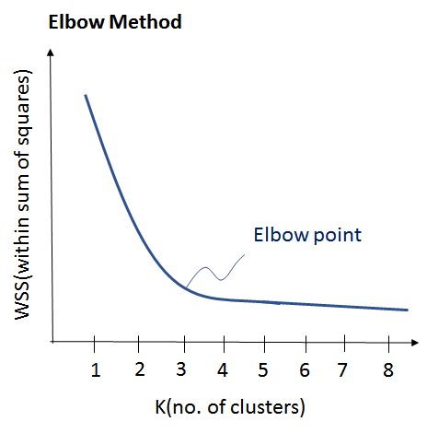
K -Means Algorithm
Finding the optimum number of Clusters i.e K value
Elbow Method

Slide 13
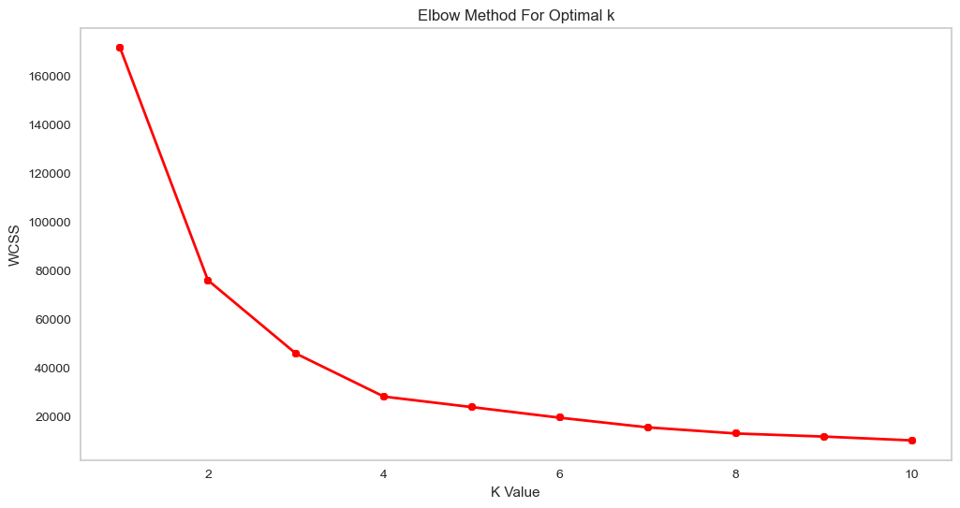
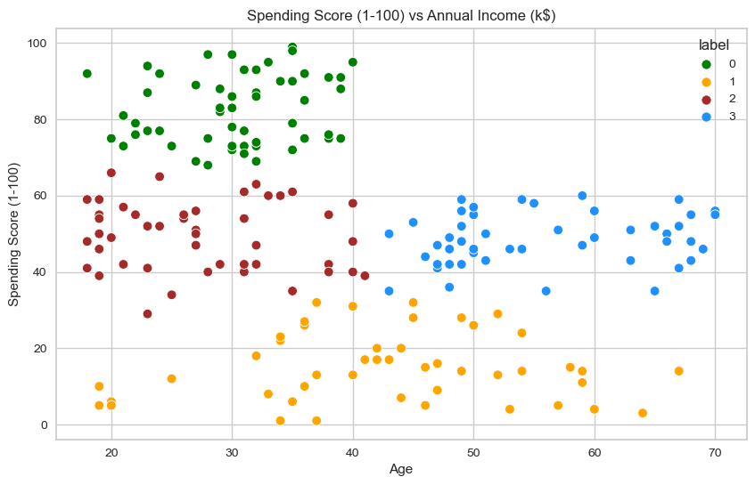
K -Means Algorithm
Client Segmentation with Age and Spending Score
Optimal No.Cluster k=4
Cluster Visualization

Slide 14
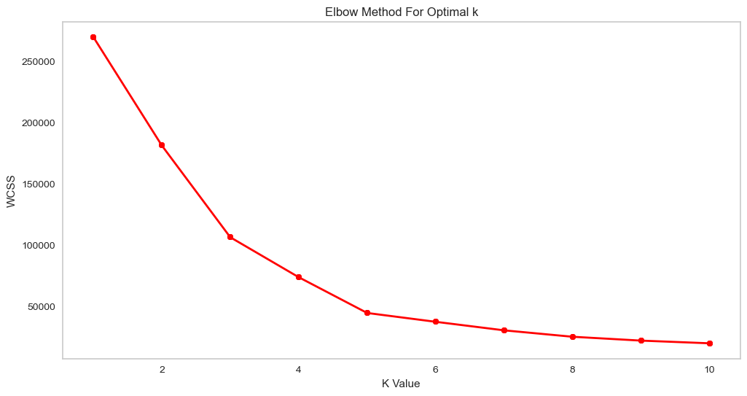
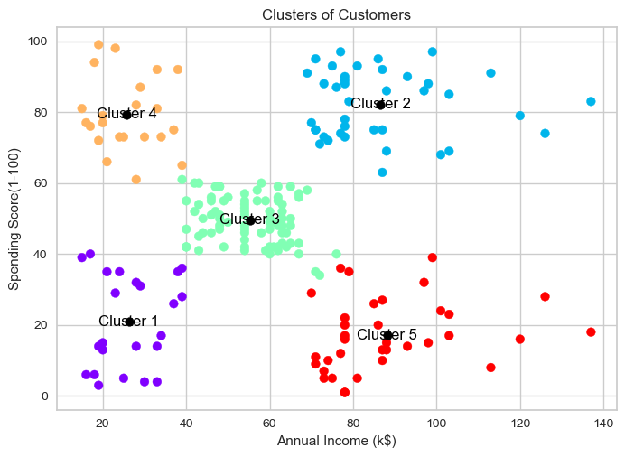
K -Means Algorithm
Client Segmentation with Annual Income and Spending Score
Optimal No.Cluster k=5
Cluster Visualization

Slide 15
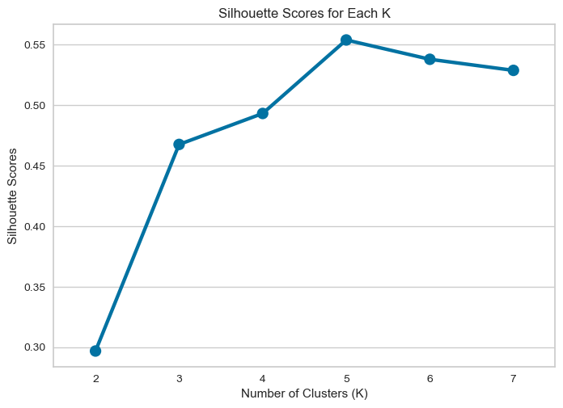
K -Means Algorithm
Evaluation with Silhouette Score for Annual Income and Spending Score
Silhouette Method

Slide 16
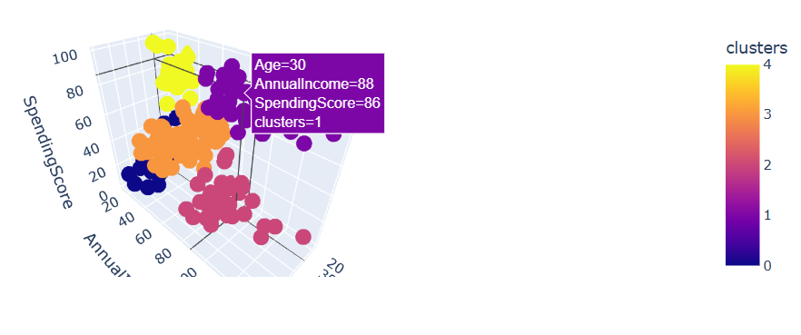
K -Means Algorithm
Client Segmentation with Annual Income,Spending Scores and Age
Cluster Visualization

Slide 17
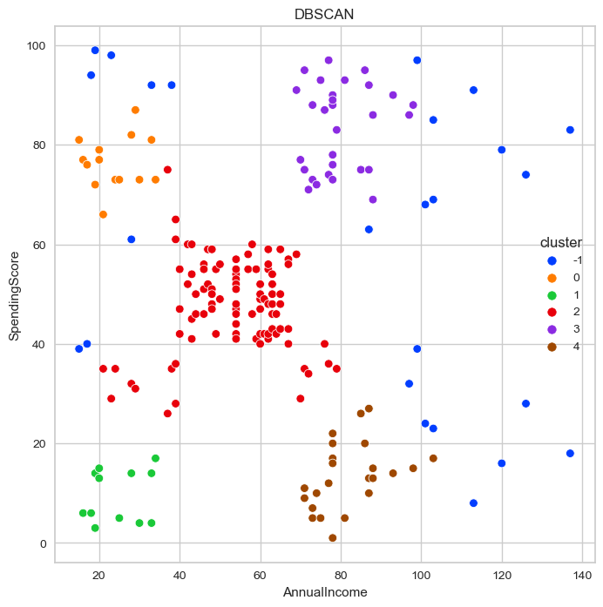
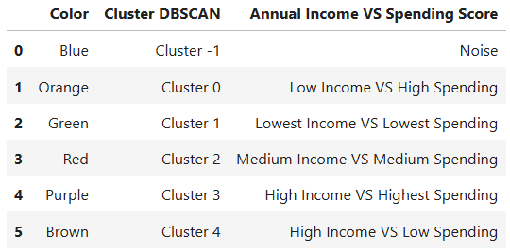
DBSCAN Model
Client Segmentation with Annual Income and Spending Score
Optimizing Minimum Sample And Epsilon
Cluster Visualization

Slide 18
Insights :
Target Cluster
Target group would be cluster 2 which has a high Spending Score and High Income
54 percent of cluster 2 shoppers are women. We should look for ways to attract these customers using a marketing campaign targeting popular items in this cluster
Cluster4 presents an interesting opportunity to maket to the customers for sales event on popular items.
Cluster5(High Income,Low Spending) we can offer special promotions and product bundles

Slide 19
Thank You!

